Slide 1
Drifter Follower
Pat Welch
August-2020

Slide 2
Data Flow
Drifter
Glider
Iridium
SBD
Goto
Generator
gliderfmc0
Iridium
Modem
Pattern
YAML
DirectIP
DirectIP
GSatMicro
Forwarder
gliderfs2
SFMC API
SFMC gliderfmc0
Drifter Path
Estimation
gliderfmc0
Dialog
Consumer
gliderfmc0
GSatMicro
Listener
gliderfmc0
SQLite3
DB
SFMC API

Slide 3
Logic Flow
Drifter GPS fixes are every 15 minutes and stored in a database
When the glider calls in the dialog is forwarded to the Dialog Consumer.
Once files are being sent from the glider to SFMC, a new goto file is generated and sent to SFMC.
After the files are done being sent from the glider to SFMC, the new goto file is sent to the glider.

Slide 4
Sample Goto
behavior_name=goto_list # Drifter follower # Generated: 2020-08-04 00:58:39+00:00 # DRIFTER pos: 44.746569, -124.699091 # vel: 0.0048, 0.0253 m/sec # speed: 0.0257 m/sec # theta: 10.8 degrees true # GLIDER pos: 44.745388, -124.681929 # speed: 0.2752 m/sec # WATER vel: 0.1631, -0.0709 m/sec # speed: 0.1779 m/sec # theta: 113.5 degrees true # PATTERNS: # i=0 PATTERN: [707,0] False # i=1 PATTERN: [-707,0] False # i=2 PATTERN: [0,707] False # i=3 PATTERN: [0,-707] False # index=0 <start:b_arg> b_arg: num_legs_to_run(nodim) -1 b_arg: start_when(enum) 0 # BAW_IMMEDIATELY b_arg: list_stop_when(enum) 7 # BAW_WHEN_WPT_DIST b_arg: initial_wpt(enum) 0 b_arg: num_waypoints(enum) 6 <end:b_arg> <start:waypoints> -12441.38386131709 4444.891010636509 # i=0, dist=692m, dt=1:58:16, 2020-08-04 02:56:55+00:00 -12442.40329811835 4445.084871441223 # i=1, dist=1393m, dt=3:56:39, 2020-08-04 06:53:34+00:00 -12441.853138407723 4445.520744841862 # i=2, dist=1086m, dt=1:06:06, 2020-08-04 07:59:40+00:00 -12441.837061421007 4444.817360891085 # i=3, dist=1303m, dt=1:13:19, 2020-08-04 09:13:00+00:00 -12441.28685376142 4445.253234375147 # i=0, dist=1086m, dt=1:06:06, 2020-08-04 10:19:06+00:00 -12442.306402952647 4445.447096164155 # i=1, dist=1393m, dt=3:56:39, 2020-08-04 14:15:45+00:00 <end:waypoints>

Slide 5
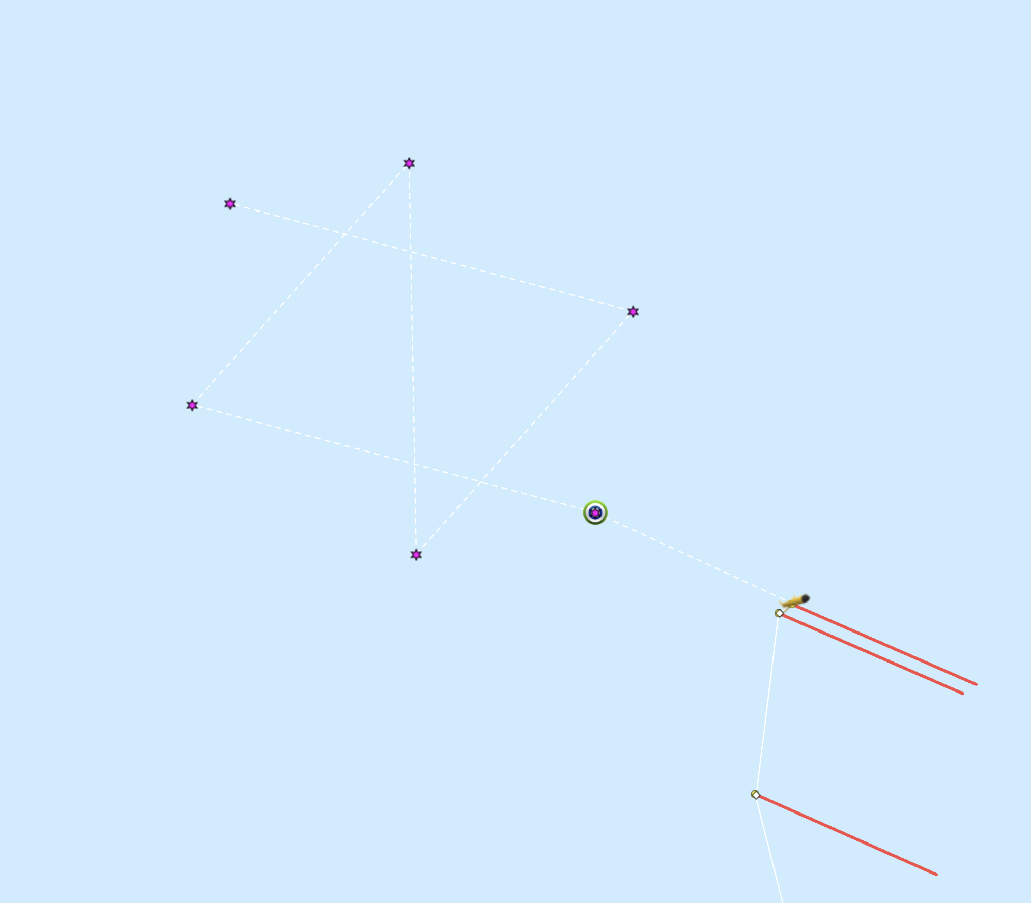
SFMC Dashboard a butterfly pattern, E->W->N->S->E Drifter moving NNE orange line

Slide 6
Software is available at
https://github.com/mousebrains/GSatMicroListener

